Slide 1
ShanghaiTech University
EE 115B: Digital Circuits
Fall 2021
Lecture 8
Hengzhao Yang
October 26, 2021

Slide 2
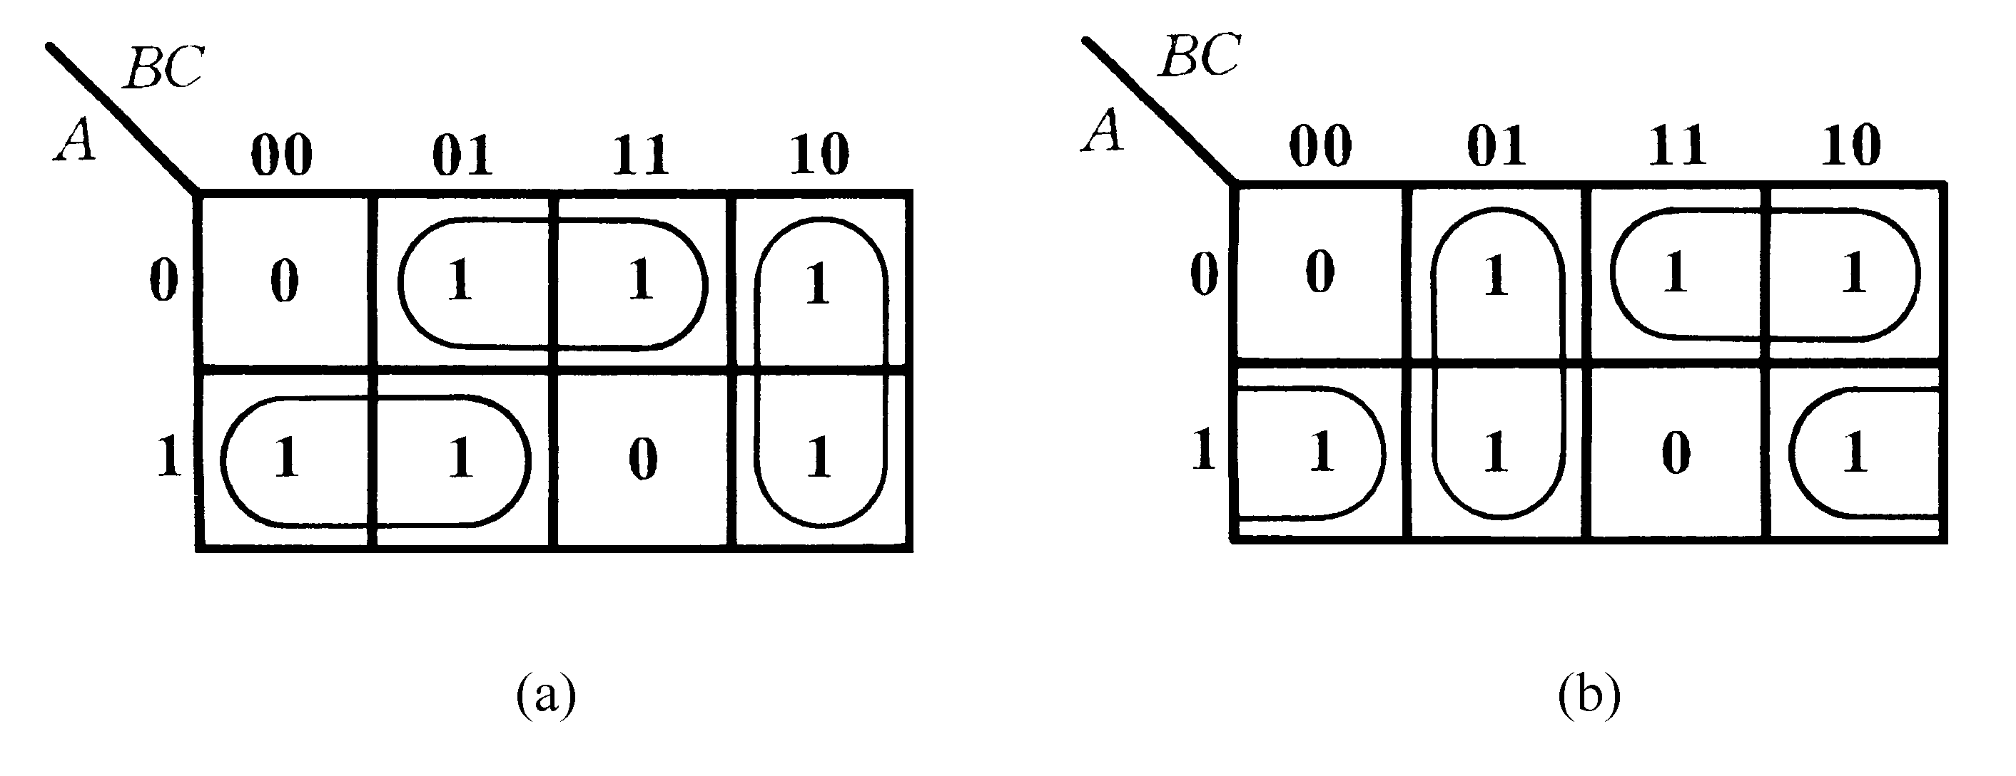


例：Determine the minimum SOP expression.
化 简 结 果 不 唯 一

Slide 3

例：Determine the minimum SOP expression.
Work on 1’s
Work on 0’s
  (a) Take 0’s as 1’s (i.e., invert truth table or K-map)
  (b) Write SOP for these 1’s to get Y’
  (c) Invert Y’ to get Y
Y’=A’D
Y=(Y’)’=A+D’
CD
 | 00 | 01 | 11 | 10
00 | 1 | 0 | 0 | 1
01 | 1 | 0 | 0 | 1
11 | 1 | 1 | 1 | 1
10 | 1 | 1 | 1 | 1
AB

Slide 4
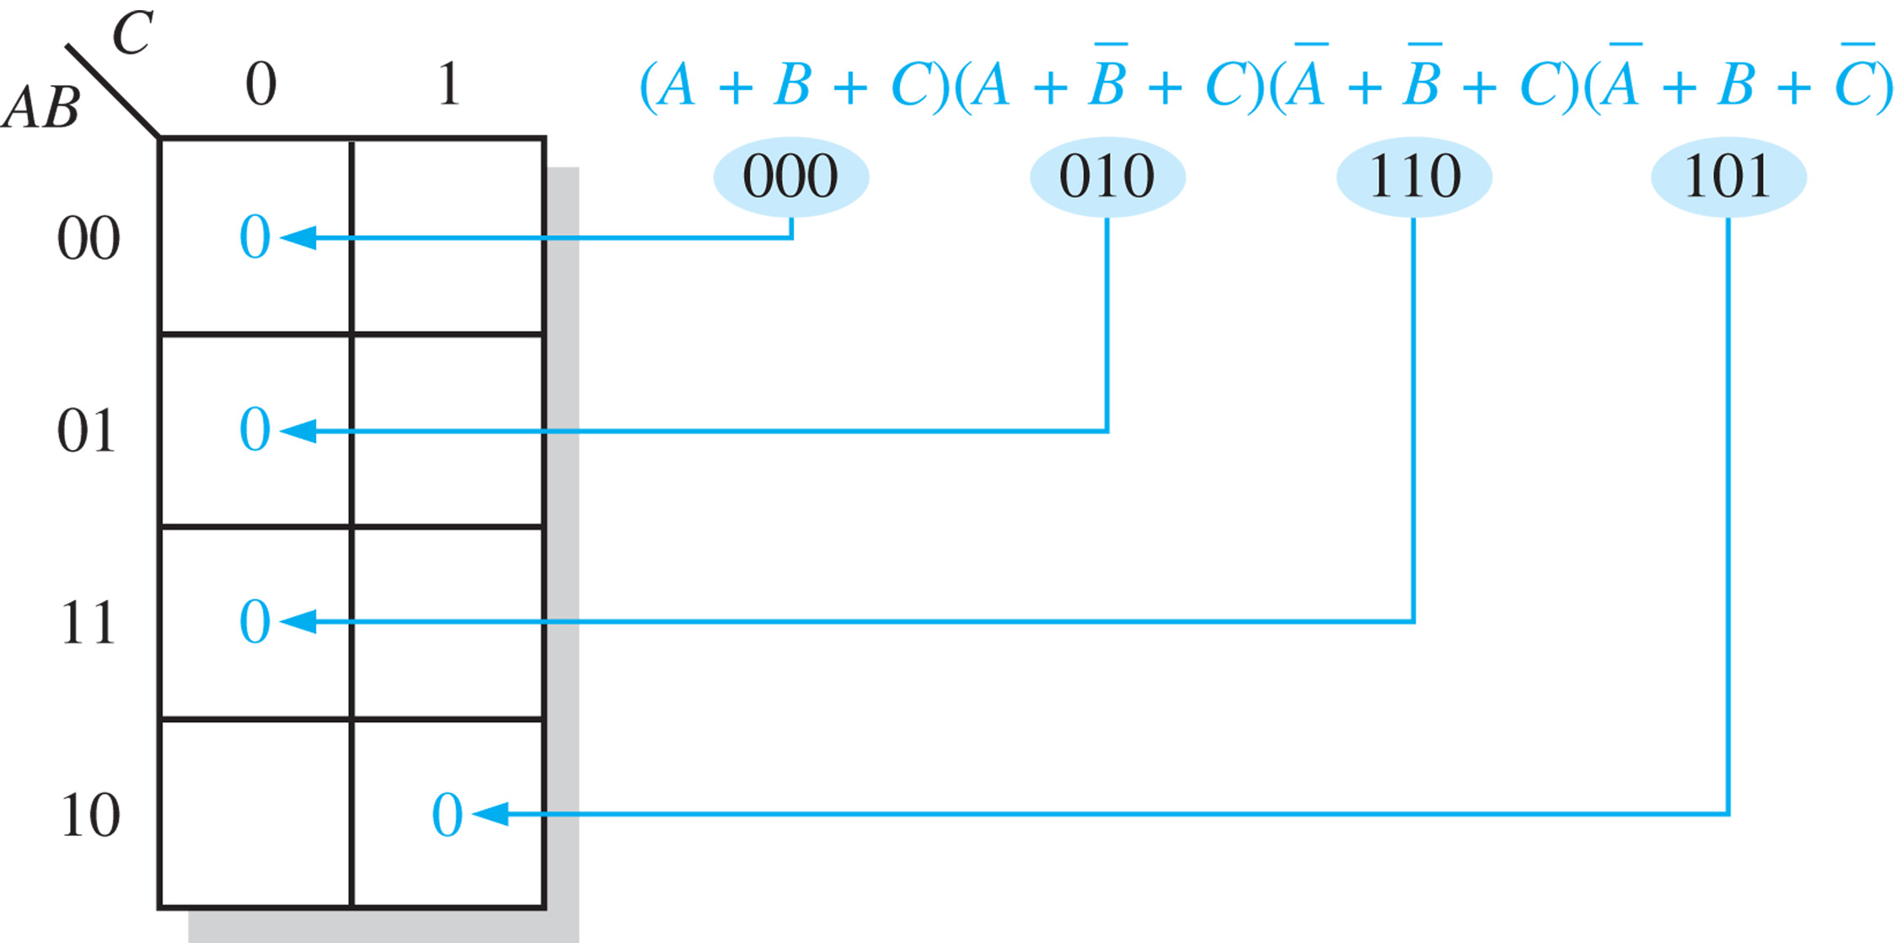
Mapping a standard POS expression
_________________________________________________
Place a “0” for each maxterm.

Slide 5
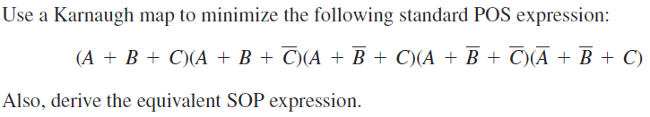
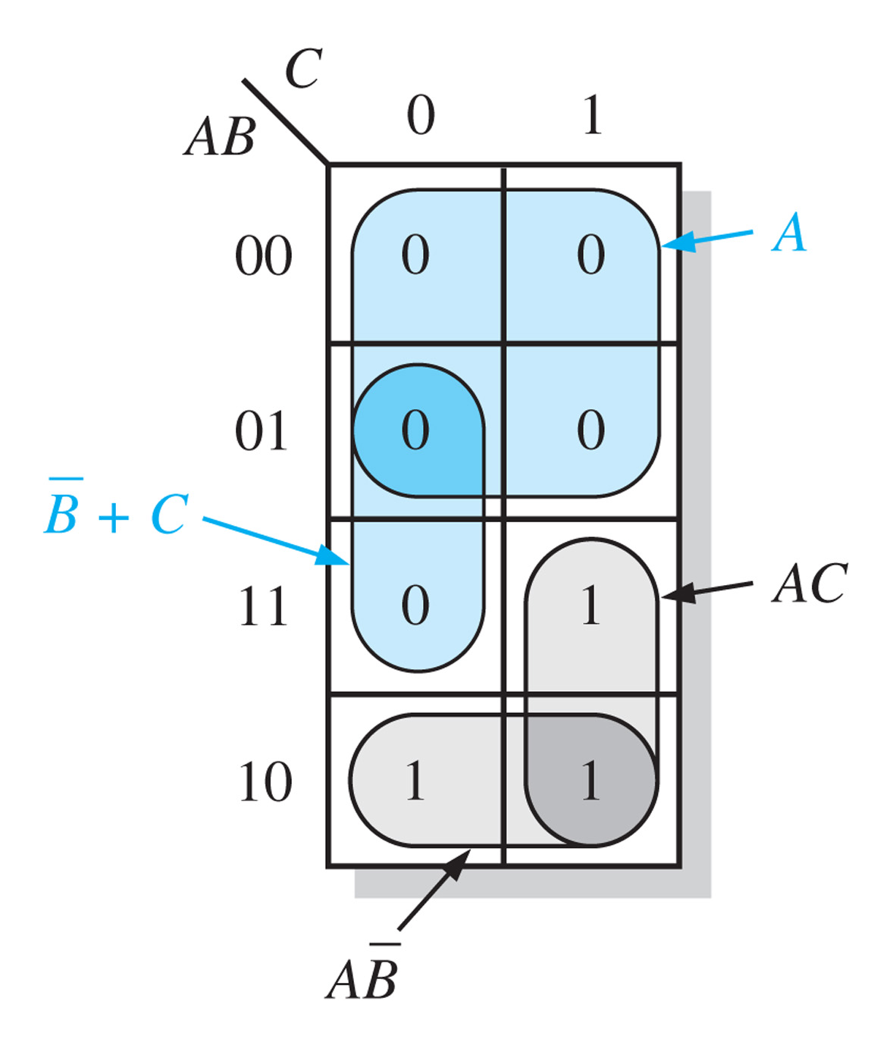


Karnaugh map simplification of POS expressions
_________________________________________________
Group 0’s to determine the minimum POS expression.
Solution: (1) Minimum POS: group 0’s
(2) Minimum SOP: group 1’s

Slide 6

Boolean Algebra and Logic Simplification
Boolean Algebra
Logic Simplification
  Karnaugh Map
  Quine-McCluskey Method
Prof. Yajun Ha

Slide 7
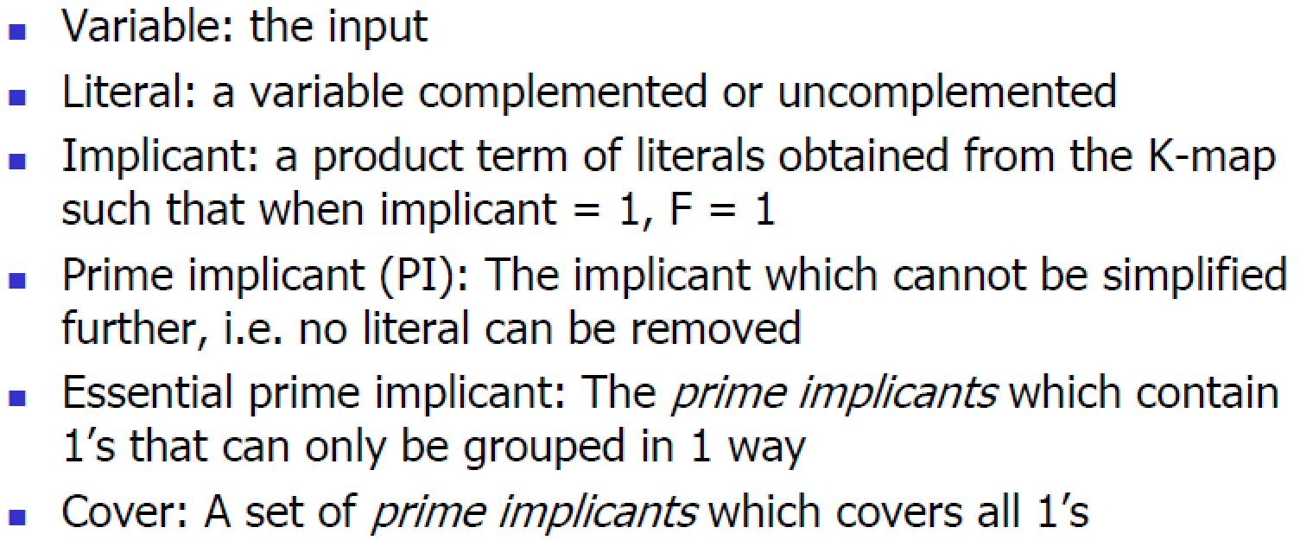
Terminology
Prof. Yajun Ha

Slide 8
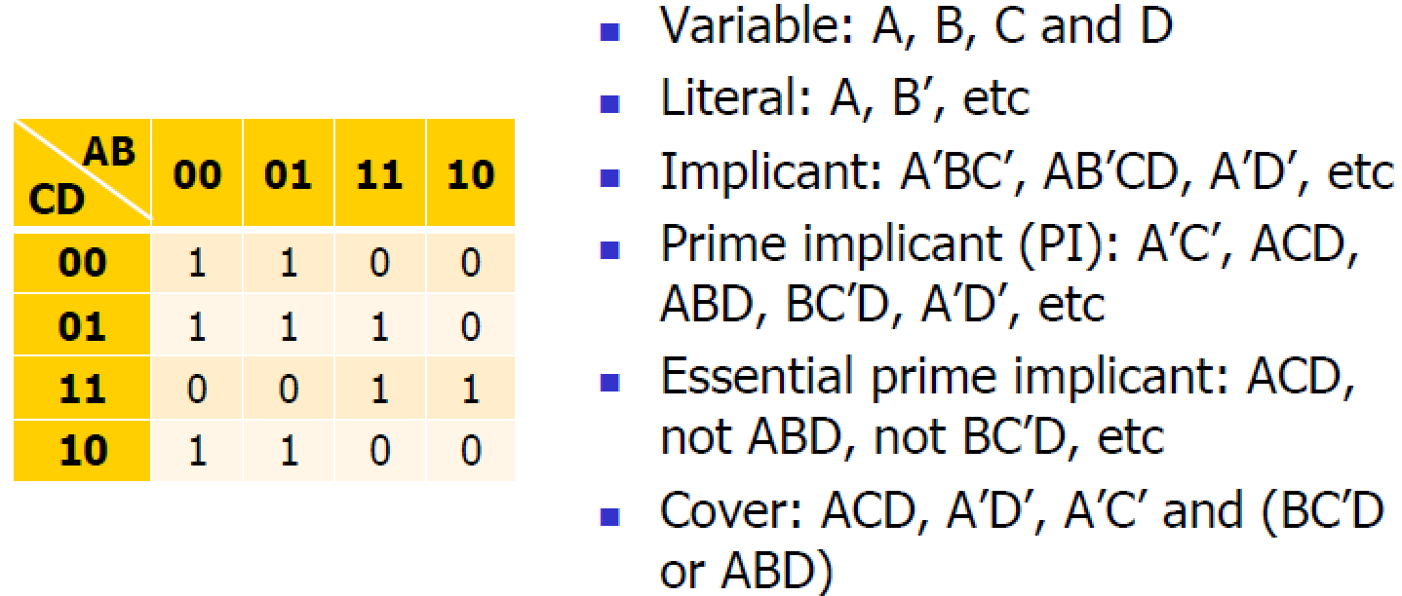
Terminology Example
Prof. Yajun Ha

Slide 9
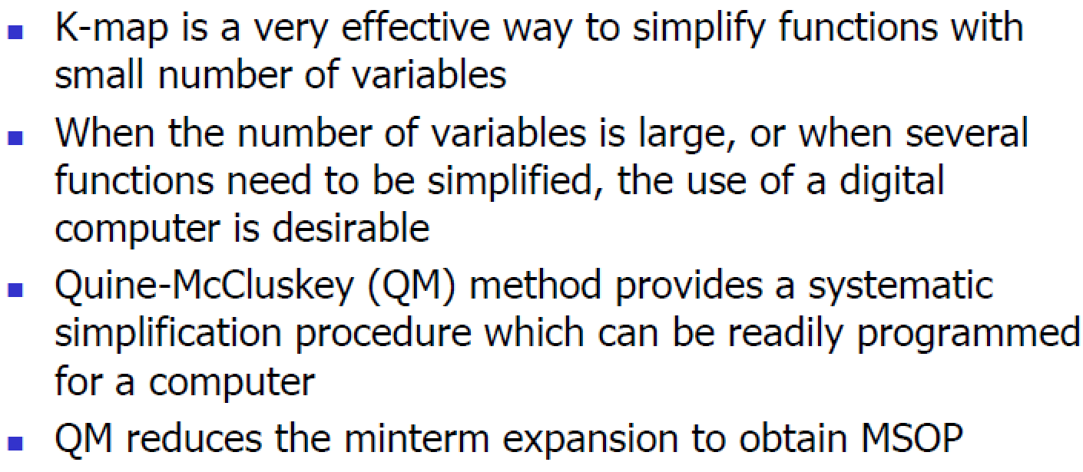
Limitations of K-Map
Prof. Yajun Ha

Slide 10
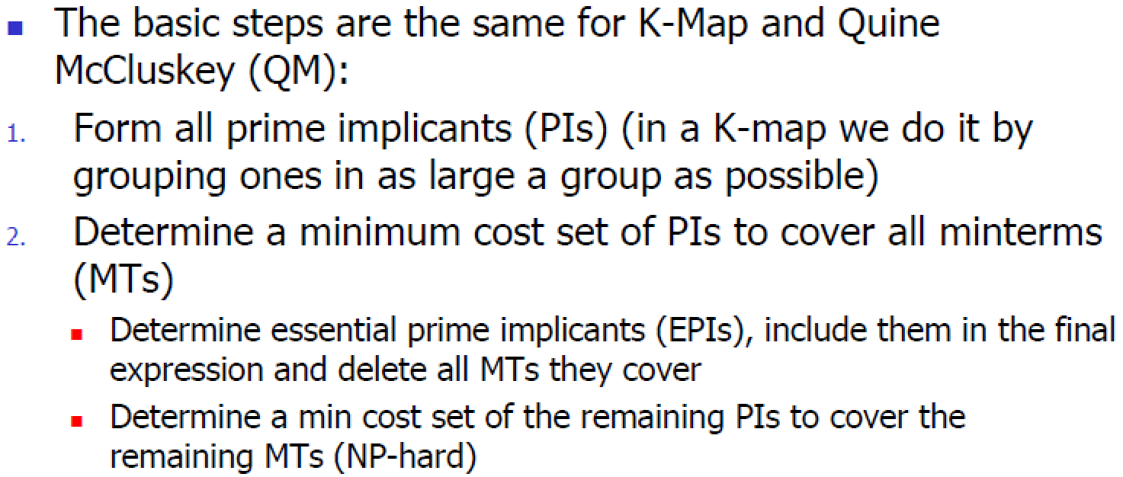
Basic Two-level QM Minimization Steps
Prof. Yajun Ha

Slide 11
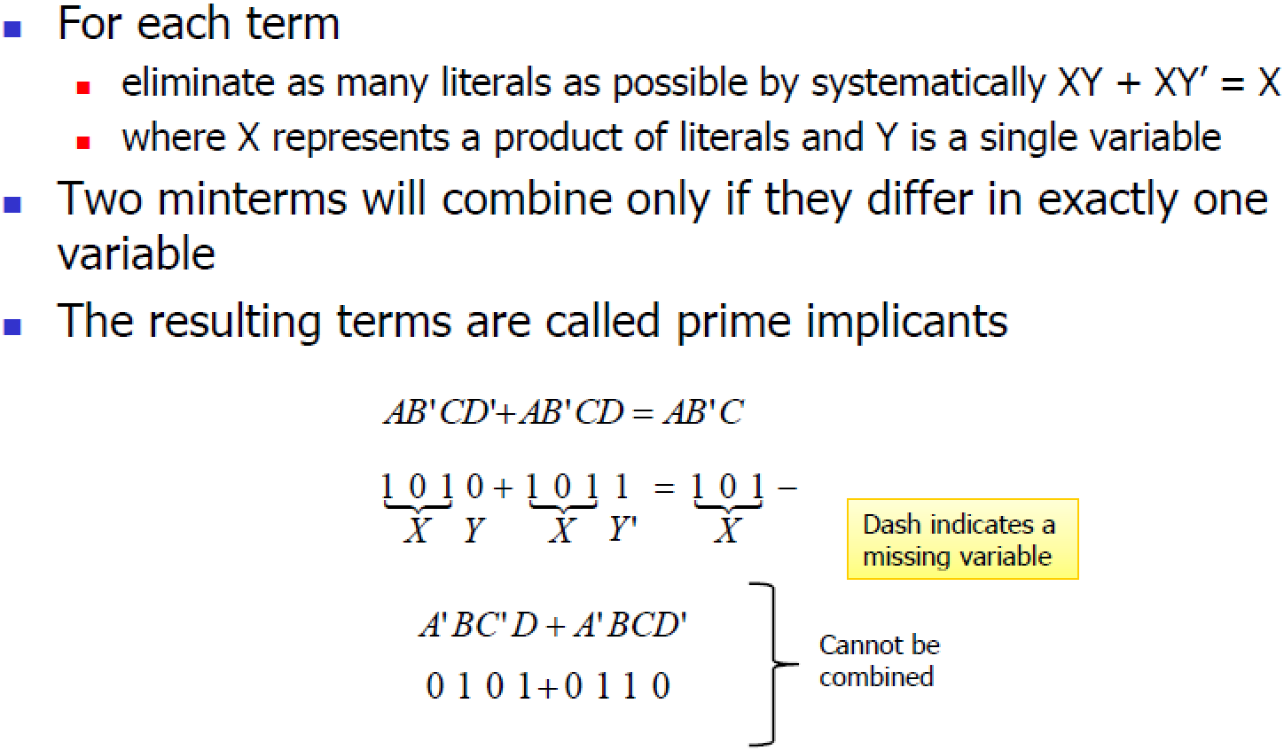
Determination of Prime Implicants
Prof. Yajun Ha

Slide 12
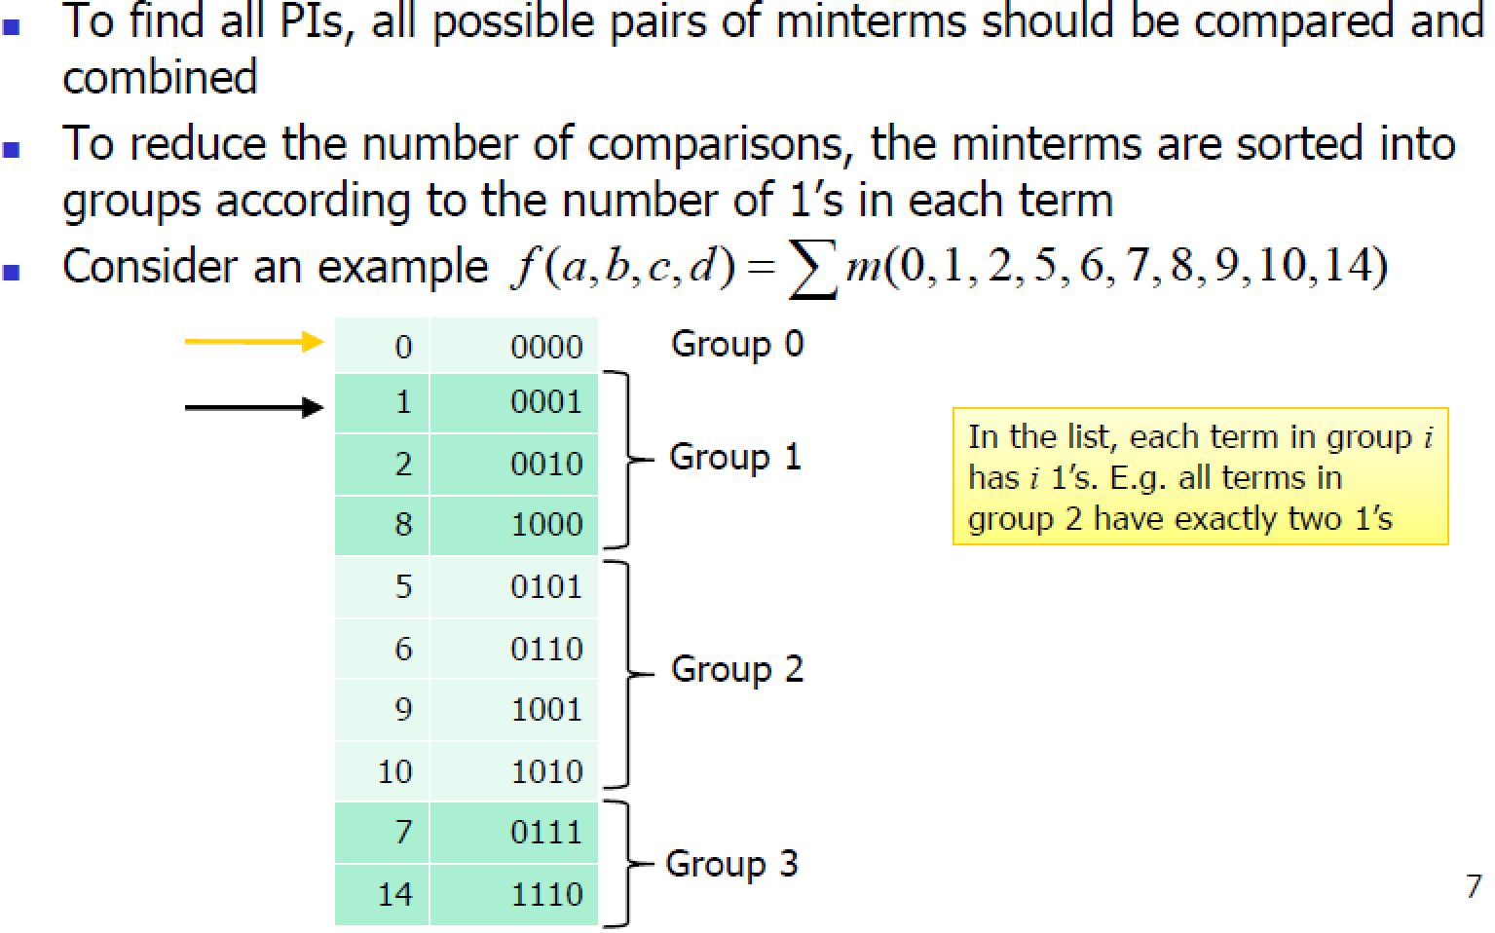
Determination of Prime Implicants
Prof. Yajun Ha

Slide 13
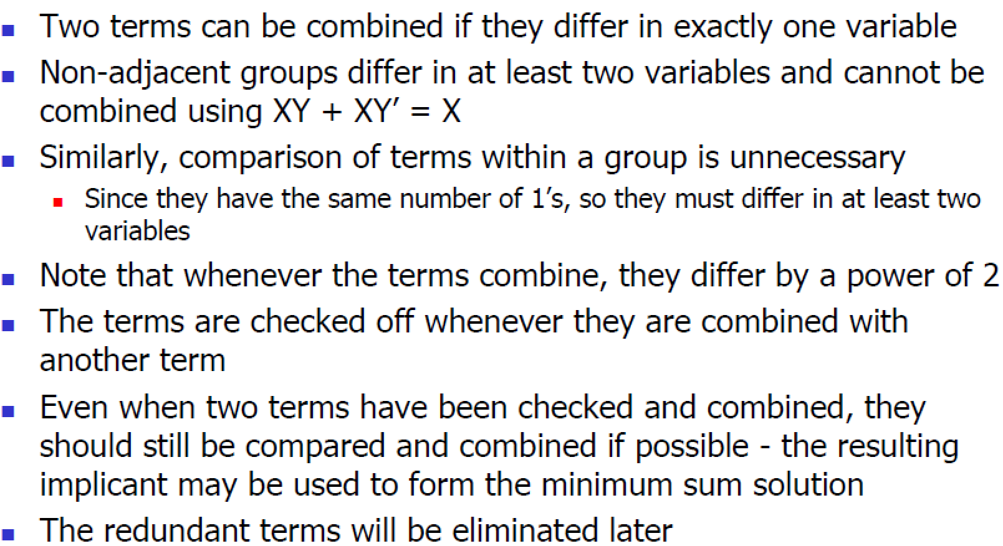
Determination of Prime Implicants
Prof. Yajun Ha

Slide 14
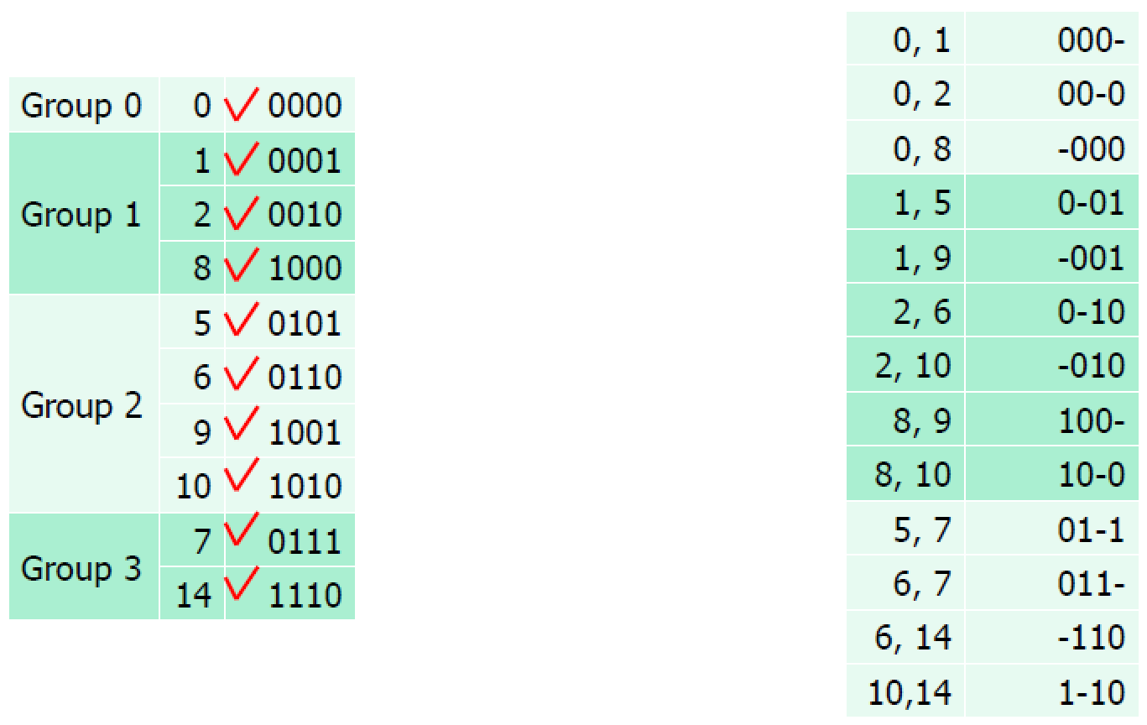
Determination of Prime Implicants
Prof. Yajun Ha

Slide 15
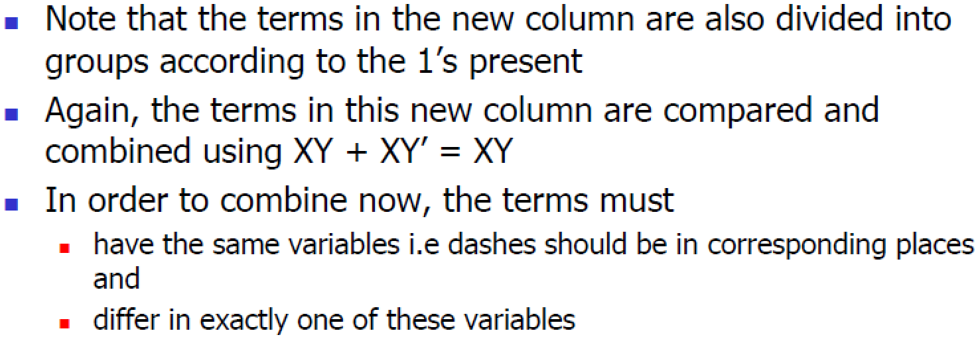
Determination of Prime Implicants
Prof. Yajun Ha

Slide 16
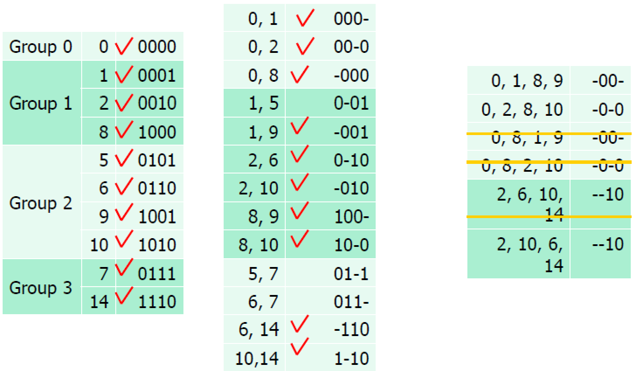
Determination of Prime Implicants
Prof. Yajun Ha

Slide 17
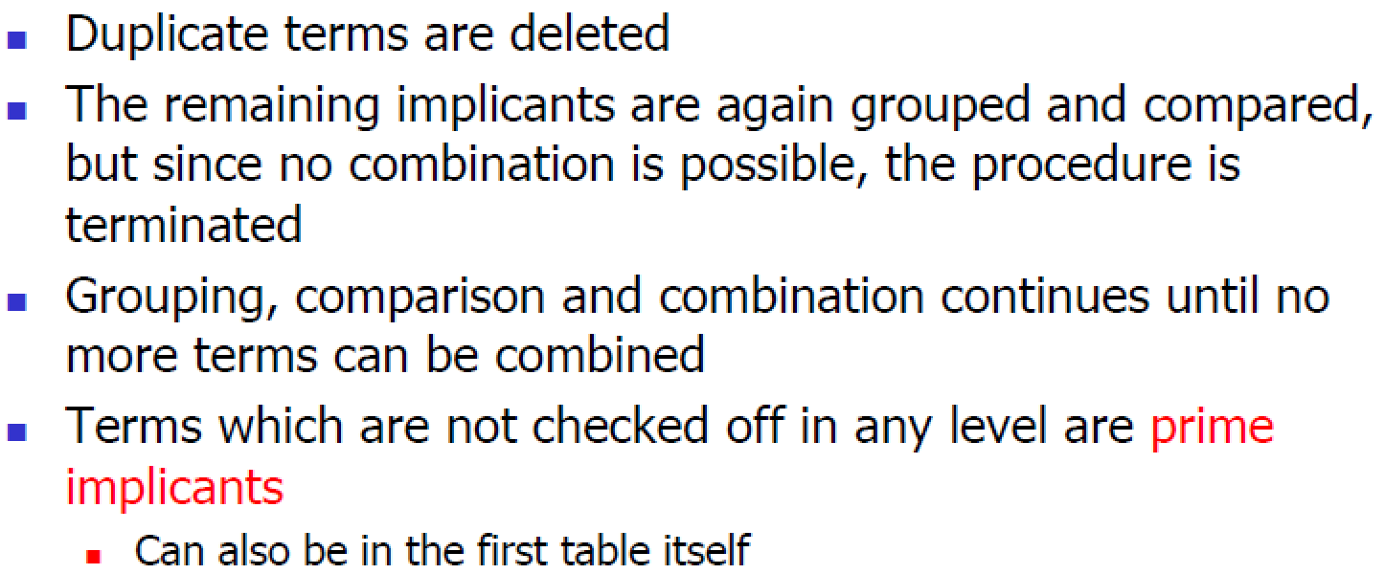
Determination of Prime Implicants
Prof. Yajun Ha

Slide 18
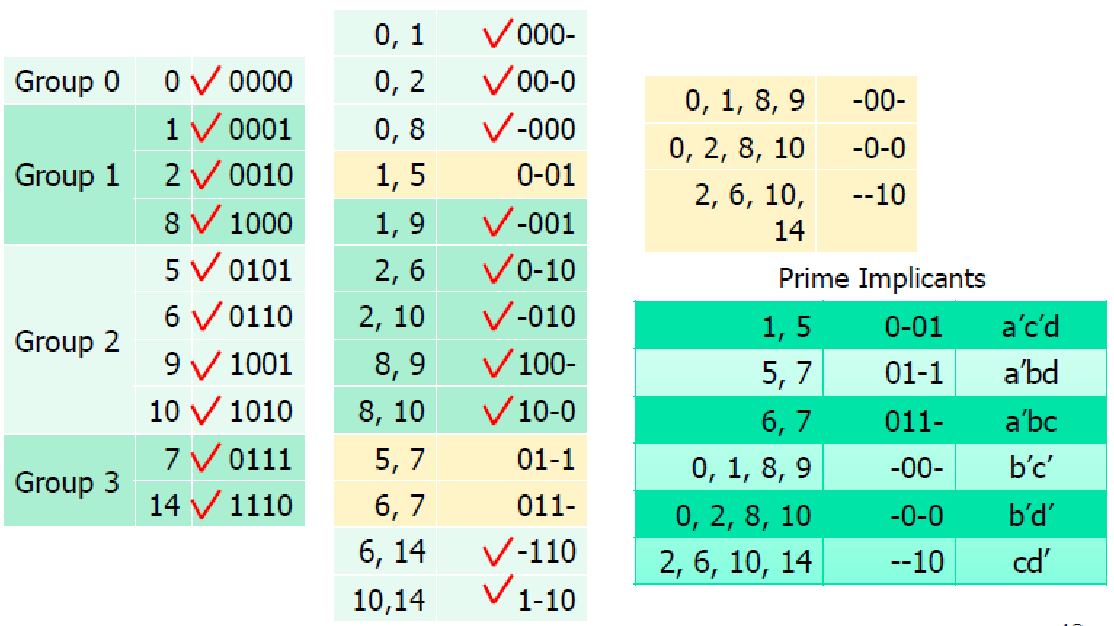
Prime Implicants
Prof. Yajun Ha

Slide 19
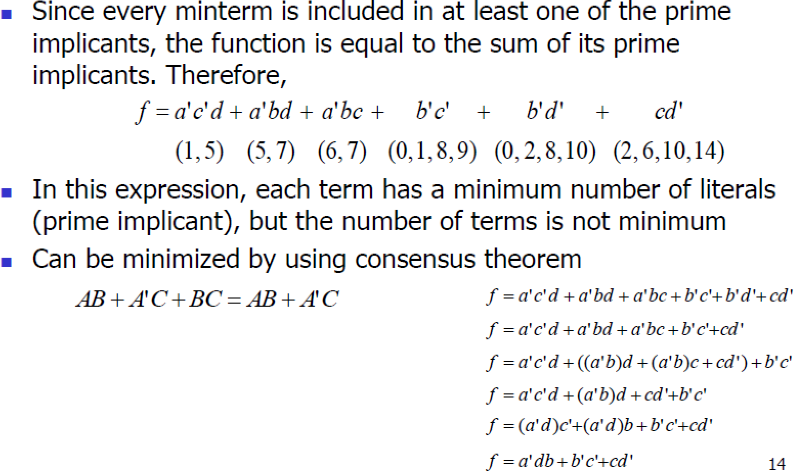
Prime Implicant Cover
Prof. Yajun Ha

Slide 20
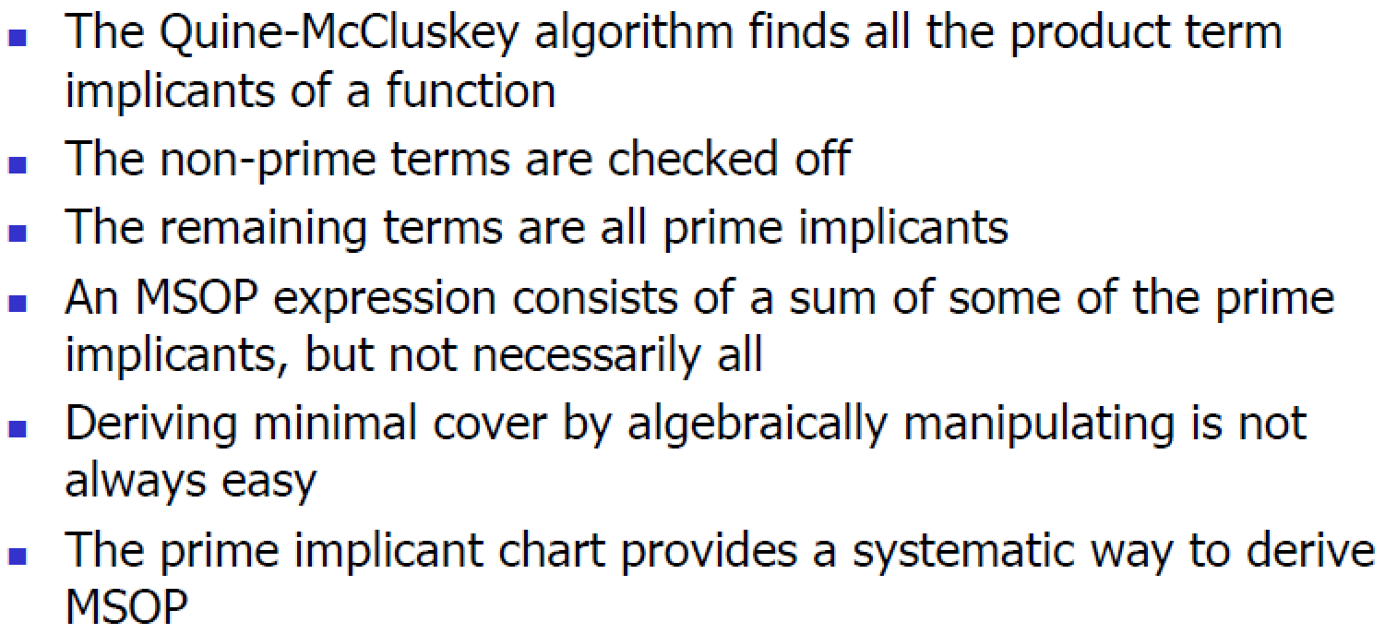
Prime Implicant Cover
Prof. Yajun Ha

Slide 21
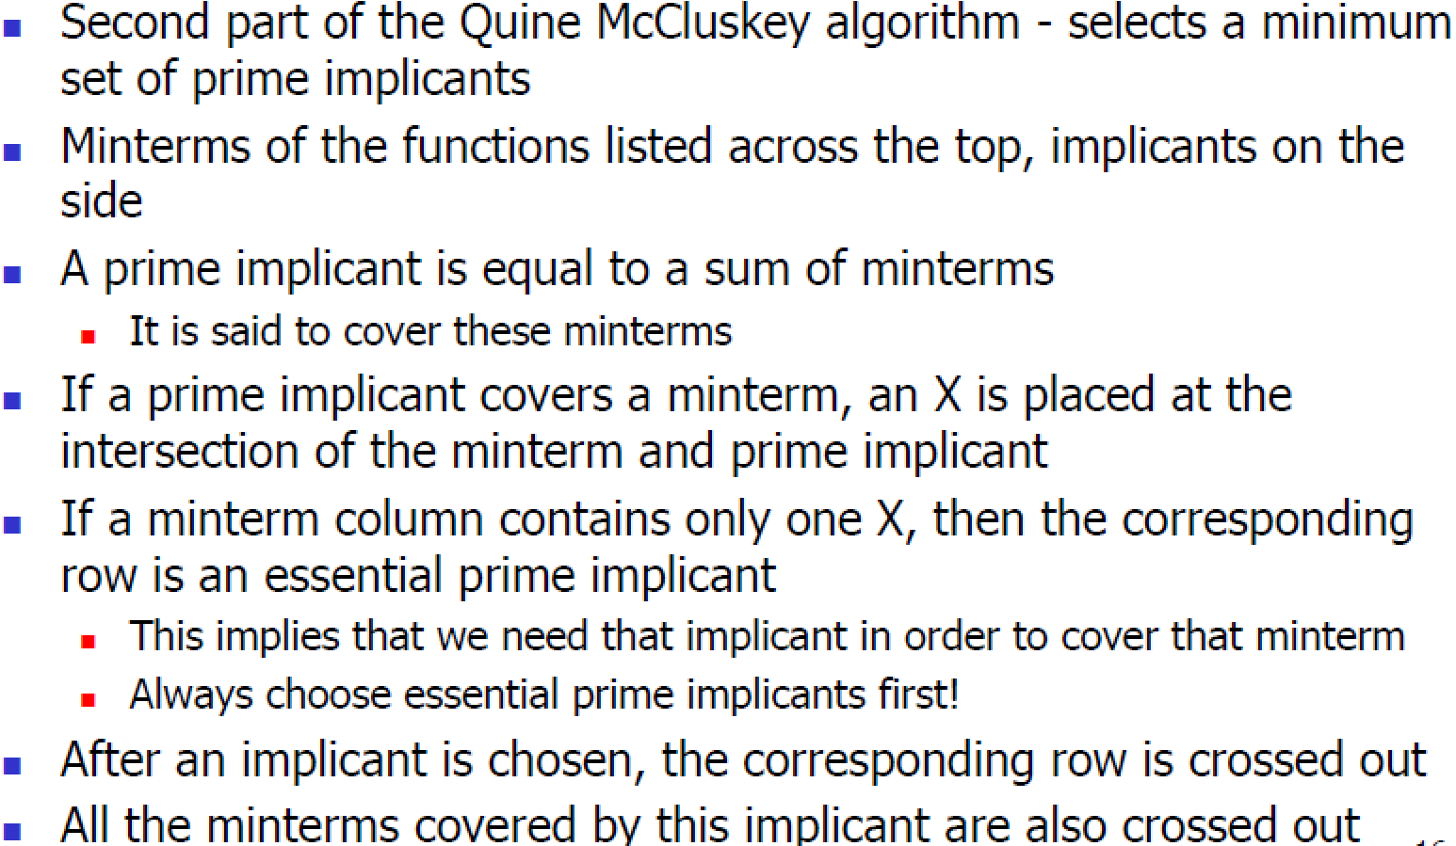
Prime Implicant Chart
Prof. Yajun Ha

Slide 22
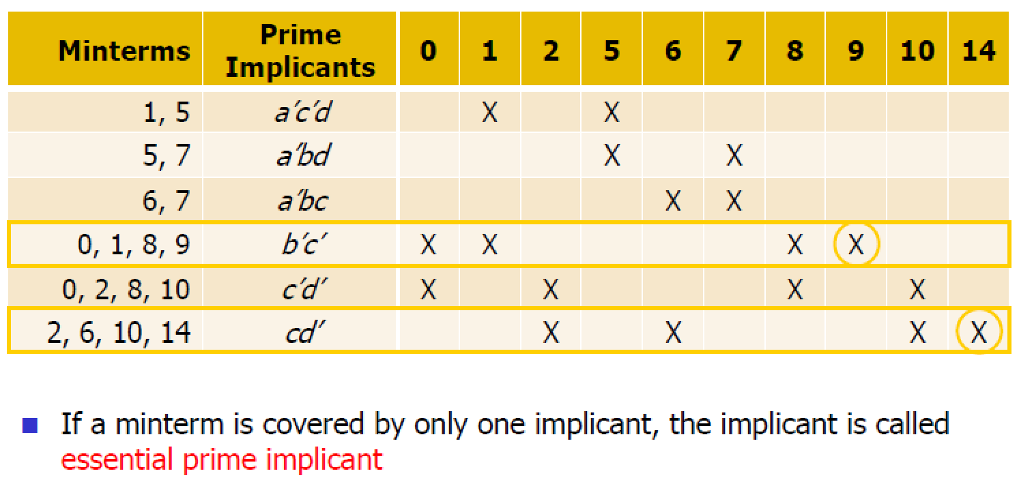
Prime Implicant Chart
Prof. Yajun Ha

Slide 23
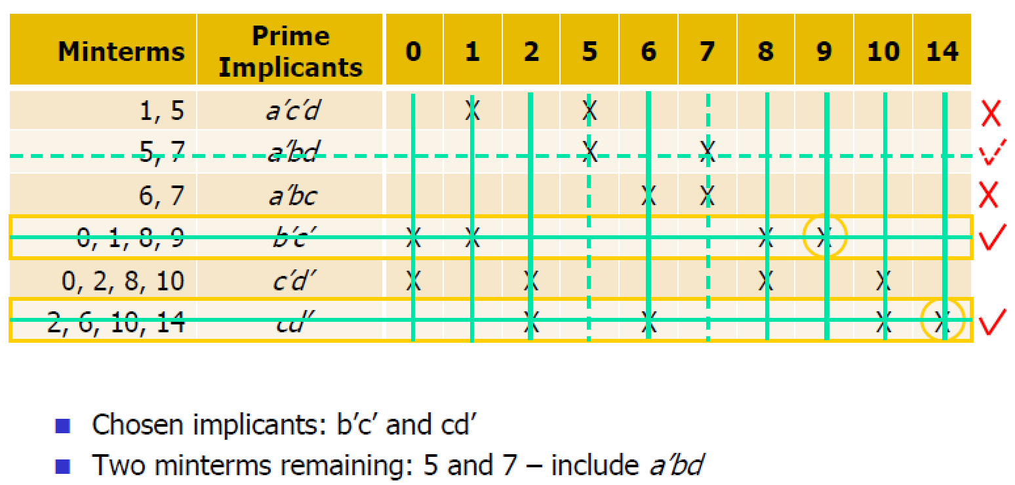
Prime Implicant Chart
Prof. Yajun Ha

Slide 24
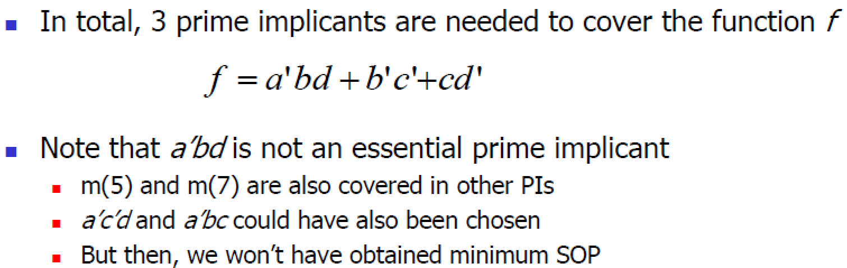
Minimal Cover
Prof. Yajun Ha

